Slide 1
Translation
Decoding the message

Slide 2
Protein Synthesis
DNA and RNA work together to produce proteins
Remember: A protein is a specific sequence of amino acids

Slide 3
Protein Review
Proteins are made by joining amino acids together into long chains, called polypeptides.
The bond that forms between amino acids is called a peptide bond

Slide 4
The Genetic Code
What is the genetic code, and how is it read?
The genetic code is read three “letters” at a time, so that each “word” is three bases long and corresponds to a single amino acid.
The first step in decoding genetic messages is to transcribe a nucleotide base sequence from DNA to RNA.
Then the RNA is decoded to make a protein

Slide 5
Codons
Each three-letter “word” in mRNA is known as a codon.
A codon is a combination of 3 mRNA bases that codes for a specific amino acid.

Slide 6
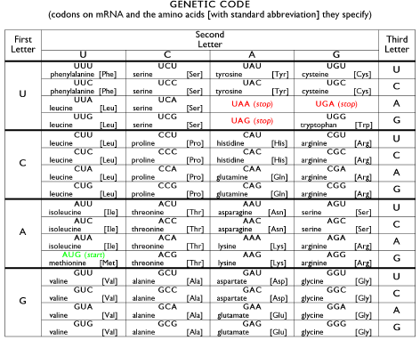

Slide 7
Using your codon chart, determine the amino acid that would code for the mRNA sequences below:
UAC:
Tyrosine
AUG:
Start codon: tells the ribosome to start building a protein
UGA:
Stop codon: causes the ribosome to stop adding amino acids

Slide 8
Translation
The process of assembling proteins from RNA
RNA moves from the nucleus where it was transcribed from DNA. It moves into the cytoplasm to a ribosome which assembles the protein
The codon on the mRNA matches up with the anticodon on the tRNA
Translation Animation

Slide 9
Review
DNA is transcribed into RNA then RNA is translated into proteins

